Slide 1
Proposal for Community Insights – PowerApps

Slide 2

Agenda
High Level Project Scope
Scope for Insights Management/Admin Module
Scope for Community Insights Module
Development Methodology and Project Delivery
Phases for Project Delivery
Proposed Delivery Plan
Commercials

Slide 3
High Level Project scope
NEC SWS India to help develop Phase 1 - Initial Apps & support for Demands.
The two Apps to be developed are
Community Insights (mobile, tablets) – for end User
Insights Management/Admin (Tablet/larger device in Landscape format, Desktop.).
The two Apps will share the same data set / model
It is expected to reuse Audit/Logging Module [From OIFR/MobileID]
An independent database (Dataverse) would be created. This will interact with 14 entities

Slide 4
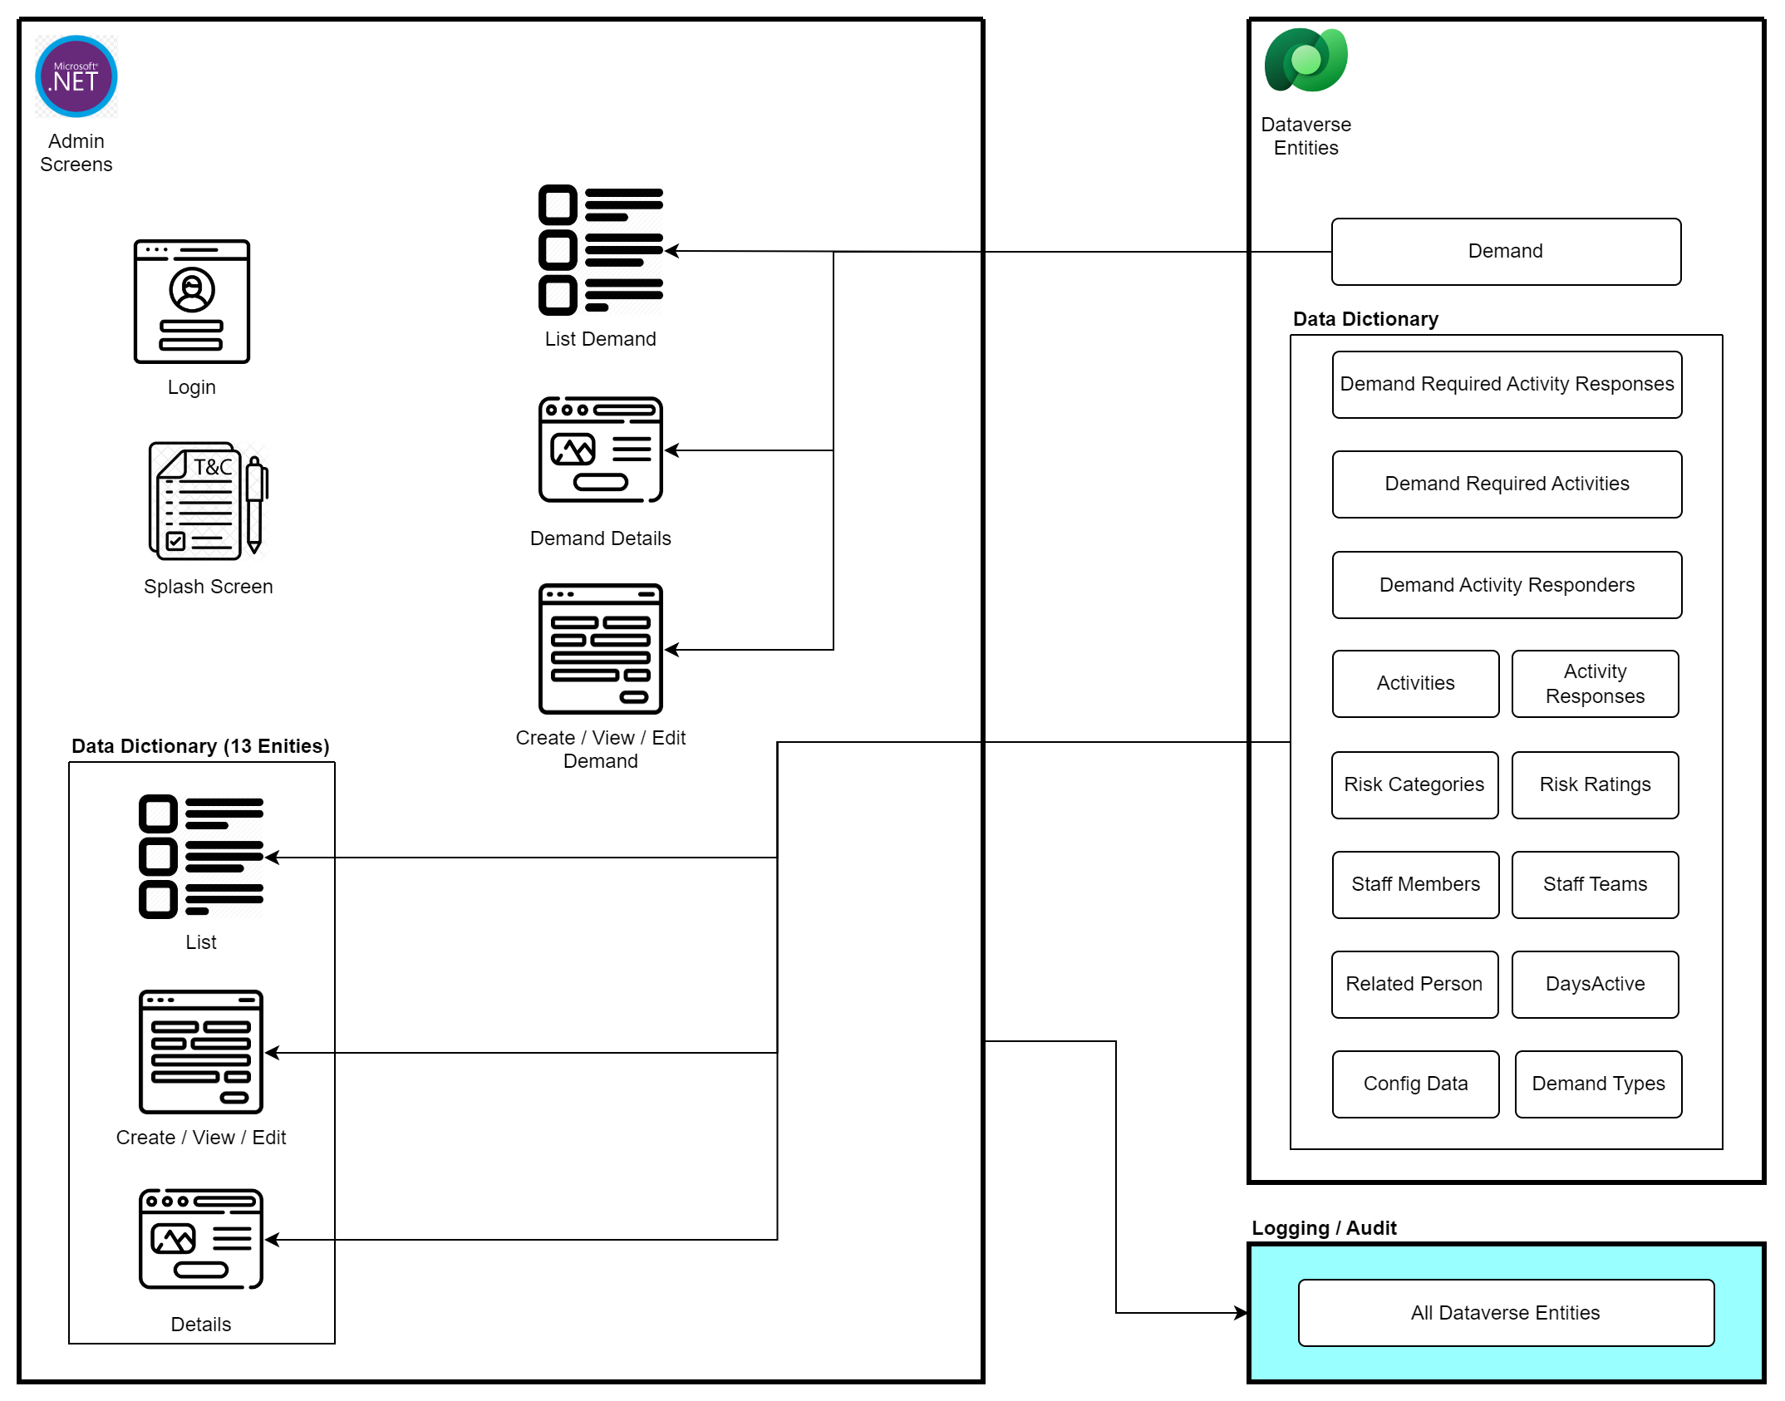
Scope for Insights Management/Admin Module

Slide 5
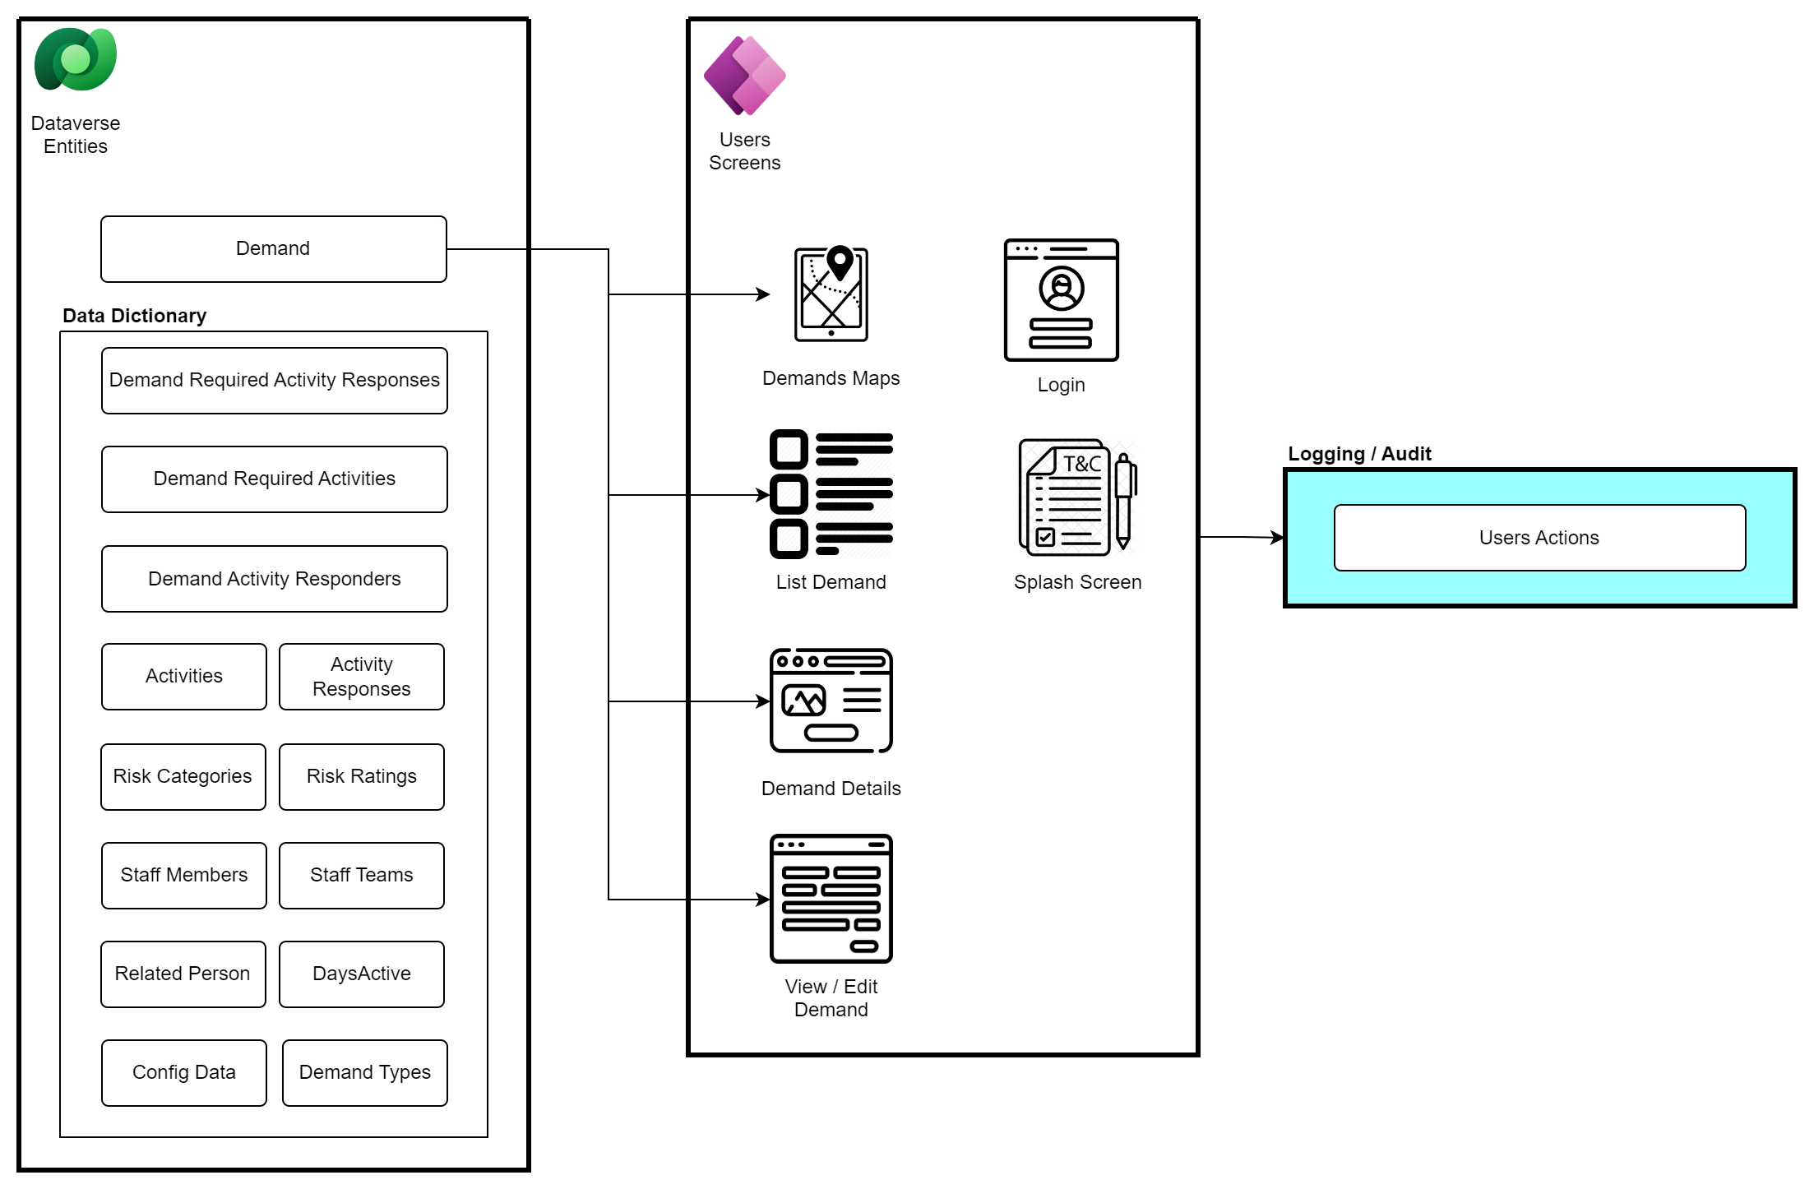
Scope for Community Insights Module

Slide 6
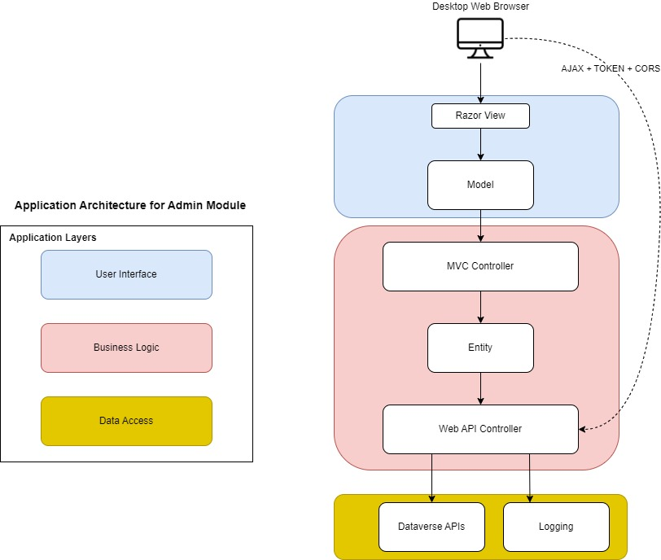
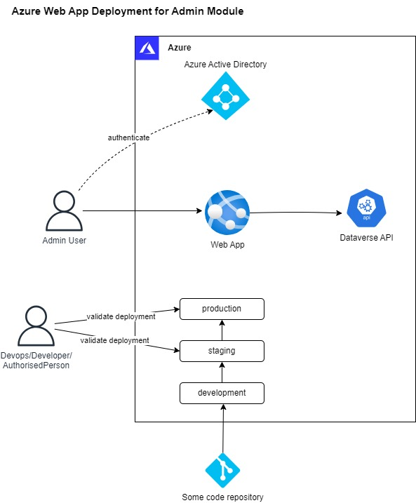
Proposed Architecture – Insights Management /Admin Module

Slide 7
Assumptions
Assumptions for Community Insights (mobile, tablets)
The UI screen design will utilize the out-of-the-box PowerApp provided UI, with no custom UI or CSS.
Assumptions for Insights Management/Admin
We have considered fields with basic validations (like mandatory check and input check).
The UI will have basic CRUD operations like list (search/pagination/sorting), view and edit
Both frontend and backend (business logic) will be in .NET.
The application will be designed for Tablet/larger device in Landscape format, Desktop.
Unit testing will be included as part of development
Out of Scope
Any Entity outside the identified 14 are deemed out of scope.
AAD management tasks, such as user creation and users to app assignment, are not within the scope of this project.
Mobile version is deemed out of scope for Insights Management/Admin application

Slide 8
Development Methodology and Project Delivery
Proposed project development methodology is Agile
Sprints will be highly collaborative
NECSWS India suggests that each Sprint be followed by week’s time of UAT. All high and critical issues can be picked up in subsequent Sprint or in the Stabilization Sprint.
After running two full development sprints, NEC proposes a stabilization sprint / hardening Sprint
A hardening sprint is recommended to maintain the quality of the product. This is an additional sprint where team will work on just improving the quality and will not pick up new stories from backlog.
Benefits:
Further stabilize the working software developed so far
Reduce the load at the time of final UAT
Reduce rework by not accumulating too much pending work, if any
Provide a realistic progress measure against planned project progress

Slide 9
Phases for Project Delivery
The project would have the following phases
Initiation Phase - Sprint 0
Development Phase (Development Sprints)
Development efforts
QA efforts
UAT efforts
UAT Support
UAT
Pre-release preparations
Go Live and Prod Support

Slide 10
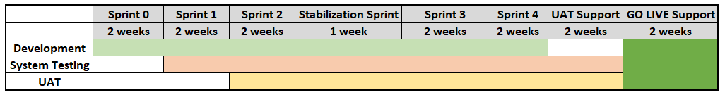
Proposed Delivery Plan
We propose the sprint delivery with the following:
Sprint 0 (2 weeks)
4 Development Sprints (2 weeks each)
1 Stabilization Sprint
1 UAT Sprint (2 weeks)
Documentation and knowledge transfer sessions. (This will run in parallel to development)
UAT will start after Sprint 1, on the stories that are set to “Done” by the Quality Analysts
Post UAT completion
GO LIVE immediately after UAT completion
2 week GO LIVE Support

Slide 11
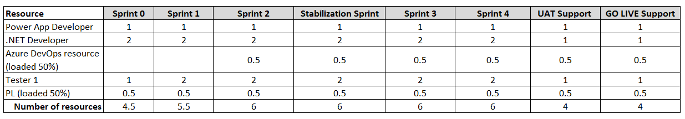
Resource Loading – Option 1
Effort for Development – 393 person days of efforts
Team of - .NET Developers, Power App Developer, DevOps developer, Quality Analysts and a project lead
The total duration would be 15 weeks.
Sprint 0 - 2 weeks
Sprint 1 - 2 weeks
Sprint 2 - 2 weeks
Stabilization Sprint - 1 week
Sprint 3 - 2 weeks
Sprint 4 - 2 weeks
UAT Support - 2 week
PROD Support - 2 week

Slide 12
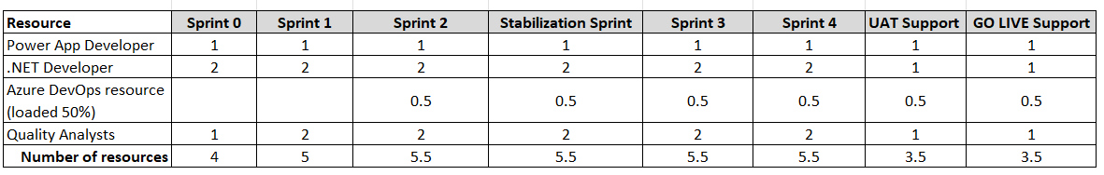
Resource Loading – Option 2
Effort for Development – 355 person days of efforts
Team of - .NET Developers, Power App Developer, DevOps developer and Quality Analysts.
No Project Lead is loaded
The total duration would be 15 weeks.
Sprint 0 - 2 weeks
Sprint 1 - 2 weeks
Sprint 2 - 2 weeks
Stabilization Sprint - 1 week
Sprint 3 - 2 weeks
Sprint 4 - 2 weeks
UAT Support - 2 week
PROD Support - 2 week

Slide 13
Commercials
Cost of Development – cost will be as per the EDC model.
(CTC and Overhead cost of the relevant resources)
The projects contract will be executed on Fixed Price basis.
Projected cost is Exclusive of: -
Any specific additional software, hardware, or other resources that NEC would require to execute these services, and which are not available with Rave.
Currently no onsite travel of Rave resource is envisaged and factored for in the cost.

Slide 14
THANK YOU
NEC Software Solutions (India)
3rd Floor, A Wing, Madhu Corporate Park,
Pandurang Budhkar Marg, Worli,
Mumbai - 400013, Maharashtra, India
T: +91(022) 6660 6600
E: india.info@necsws.com
W: www.necsws.com/india

